Slide 1
EcoWise Home Hub
Test Mavericks Forge Team
AI tools to speed up SDLC stages in Nagarro from Timisoara Romania

Slide 2
If your idea were a tweet
Brief your idea in no more than 200 characters.
EcoWise Home Hub: Save time, save cost, move more. Empower consumers with instant energy ratings, personalized recommendations, and eco-friendly choices for a sustainable future
Explain if your idea is unique or if it is an improvement of an existing solution
We all ventured in the realms of AI uncharted territories with ghost in the shells and faced many challenges in this discovery journey. We had a brilliant idea of making a comparison tool between the documentation generated by GitHub Copilot after analyzing a code repo and the existing documentation written by a human team in Docupedia or Confluence, and generate a sort of technical debt percentage, but we realized it can’t be done in such a short time. In this document we highlight some cool available AI tools that can for sure help speed up a lot of processes like sales pitches, POCs and RFPs in Nagarro.
After gaining strength from that we come with this pitch: Many existing applications may specialize in energy ratings, product comparisons, or personalized recommendations individually. EcoWise Home Hub, however, brings all these essential features together into a cohesive and user-friendly platform. The seamless integration allows users to make well-informed decisions without having to switch between multiple apps or platforms. In summary, while there are existing solutions addressing aspects of sustainability, EcoWise Home Hub's uniqueness lies in its combination of features, synthetic approach, personalized recommendations, educational resources, and community engagement. Or at least that’s what we tried to do in order to reduce costs & carbon Emissions By 20%
EcoWise Home Hub -Test Mavericks Forge Team

Slide 3
Explain the problem you are tackling
Reduce waste, lower costs, save the earth with robots
Perhaps we are the carbon they want to reduce. And since saving the planet by killing ourselves is a very grim idea, and now I got your full attention, ☺ we chose an application that helps the end user with the daily power management while including AI solution in every step of the process of developing that application without making use directly of github copilot or ChatGPT.
Since putting battery powered sensors in everything in your home seems not such a bright idea maybe self-monitoring your “power habits” with the use of AI can change something. We all know that old habits die hard but perhaps the path to a self-sustainable life is not so far away. In this not generated document we present some baby steps towards that path.
We tried to develop a fully functional application, we managed to have bits and pieces and a lot of ideas of how and when to apply AI tools at every step of the SDLC process journey. All steps were generated using AI tools, so result may vary. All the tools used in the process are on free trial, none of the free ones are any good.
We included small video samples that we encourage you to play
EcoWise Home Hub -Test Mavericks Forge Team

Slide 4
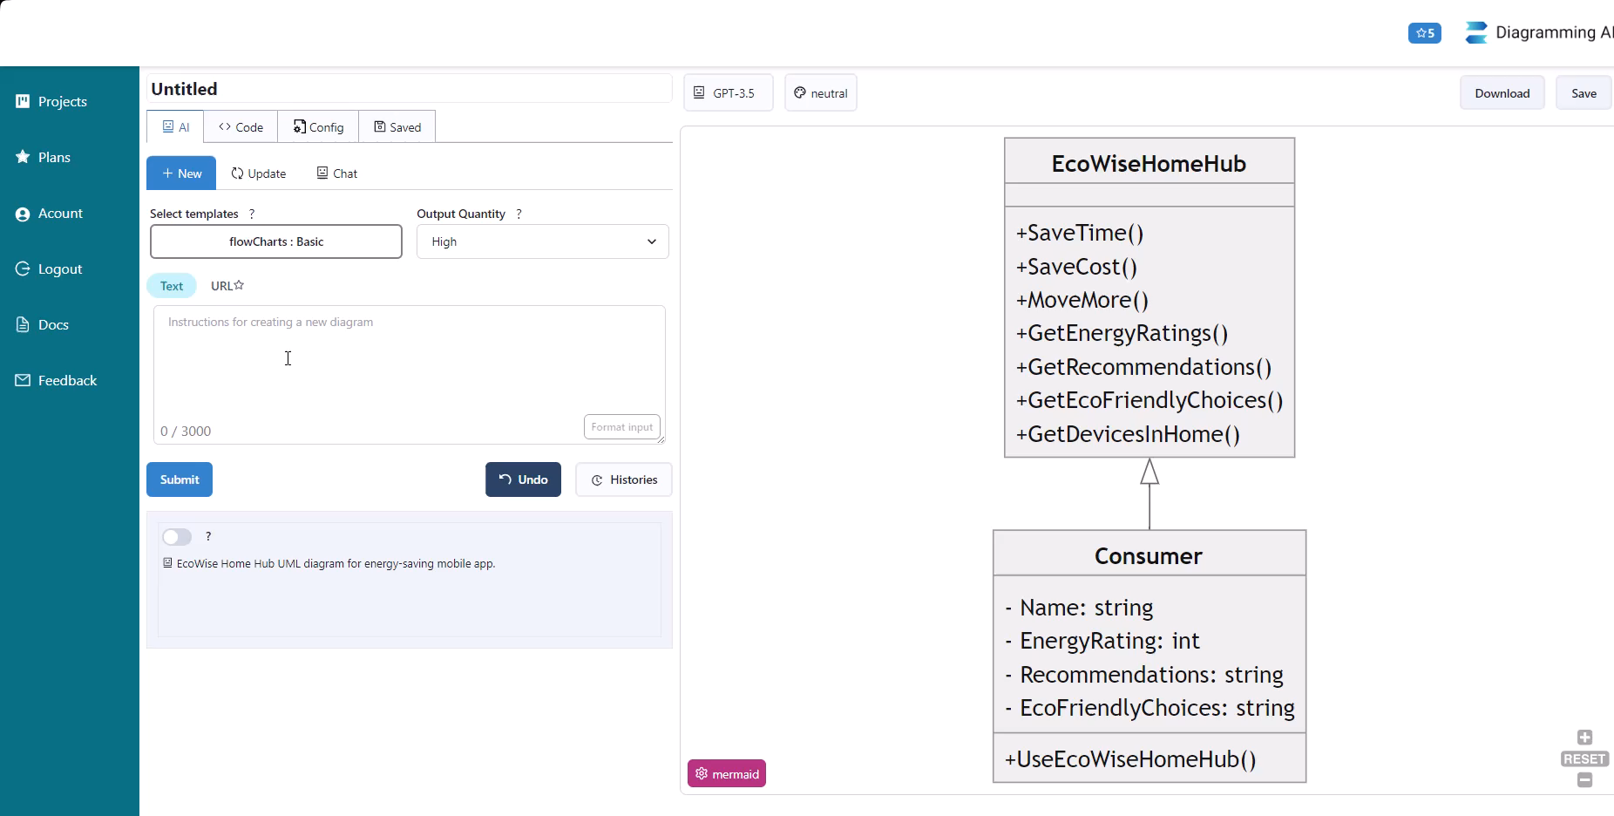
Here is how you can easily create a UI diagram with the use of AI
Better prompts result in better diagrams for your future app, for sure there is room for improvement *play video
https://diagrammingai.com https://www.eraser.io/diagramgpt

Slide 5
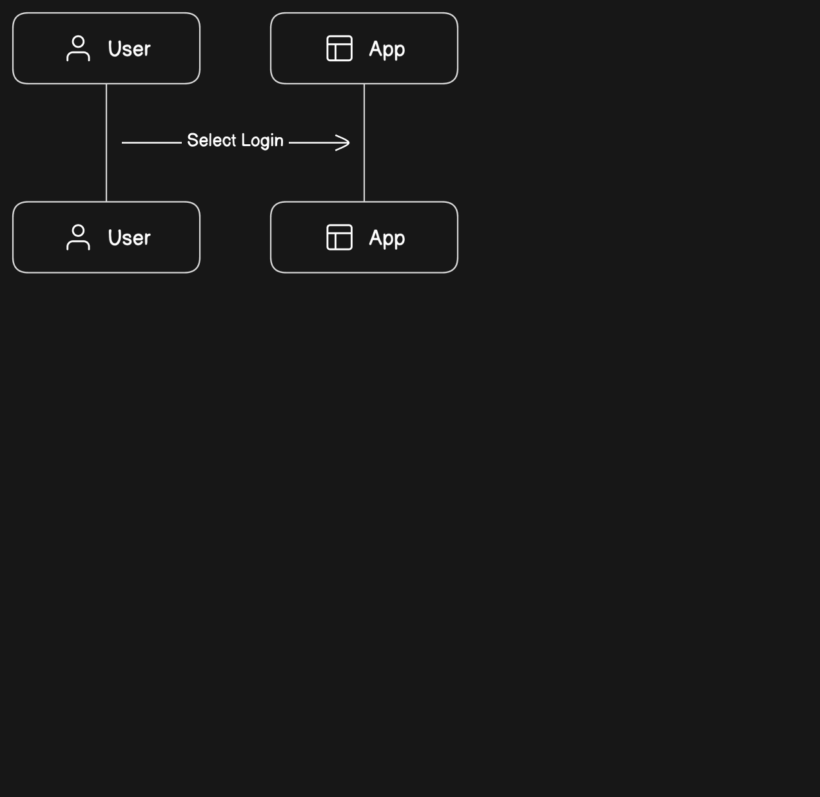
Here is how you can easily crate a UI diagram with the use of AI
Better prompts result in better diagrams for your future app, for sure there is room for improvement *play video
https://www.eraser.io/diagramgpt

Slide 6
Requirement Analysis
Tools
Userdoc is a professional tool for requirements analysis and generation
To integrate AI into our project we chose Userdoc for the following reasons:
Advanced Requirement Management: Userdoc is a modern tool with advanced capabilities for capturing and organizing user stories, personas, and user journeys, supported by intelligent AI assistance.
Integrated Project Management: the tool integrates with popular project management tools for real-time updates, streamlining workflows, and enhancing communication and coordination among team members.
Centralized Knowledge Discovery: it helps teams by centralizing critical information in one location, ensuring quick access to essential documentation, fostering transparency, and reducing the risk of miscommunication.
Comprehensive Documentation Solution:Beyond requirement management, Userdoc provides a robust foundation for long-term documentation, supporting future reference, audits, and continuous improvement throughout the project lifecycle
https://userdoc.fyi/#features

Slide 7
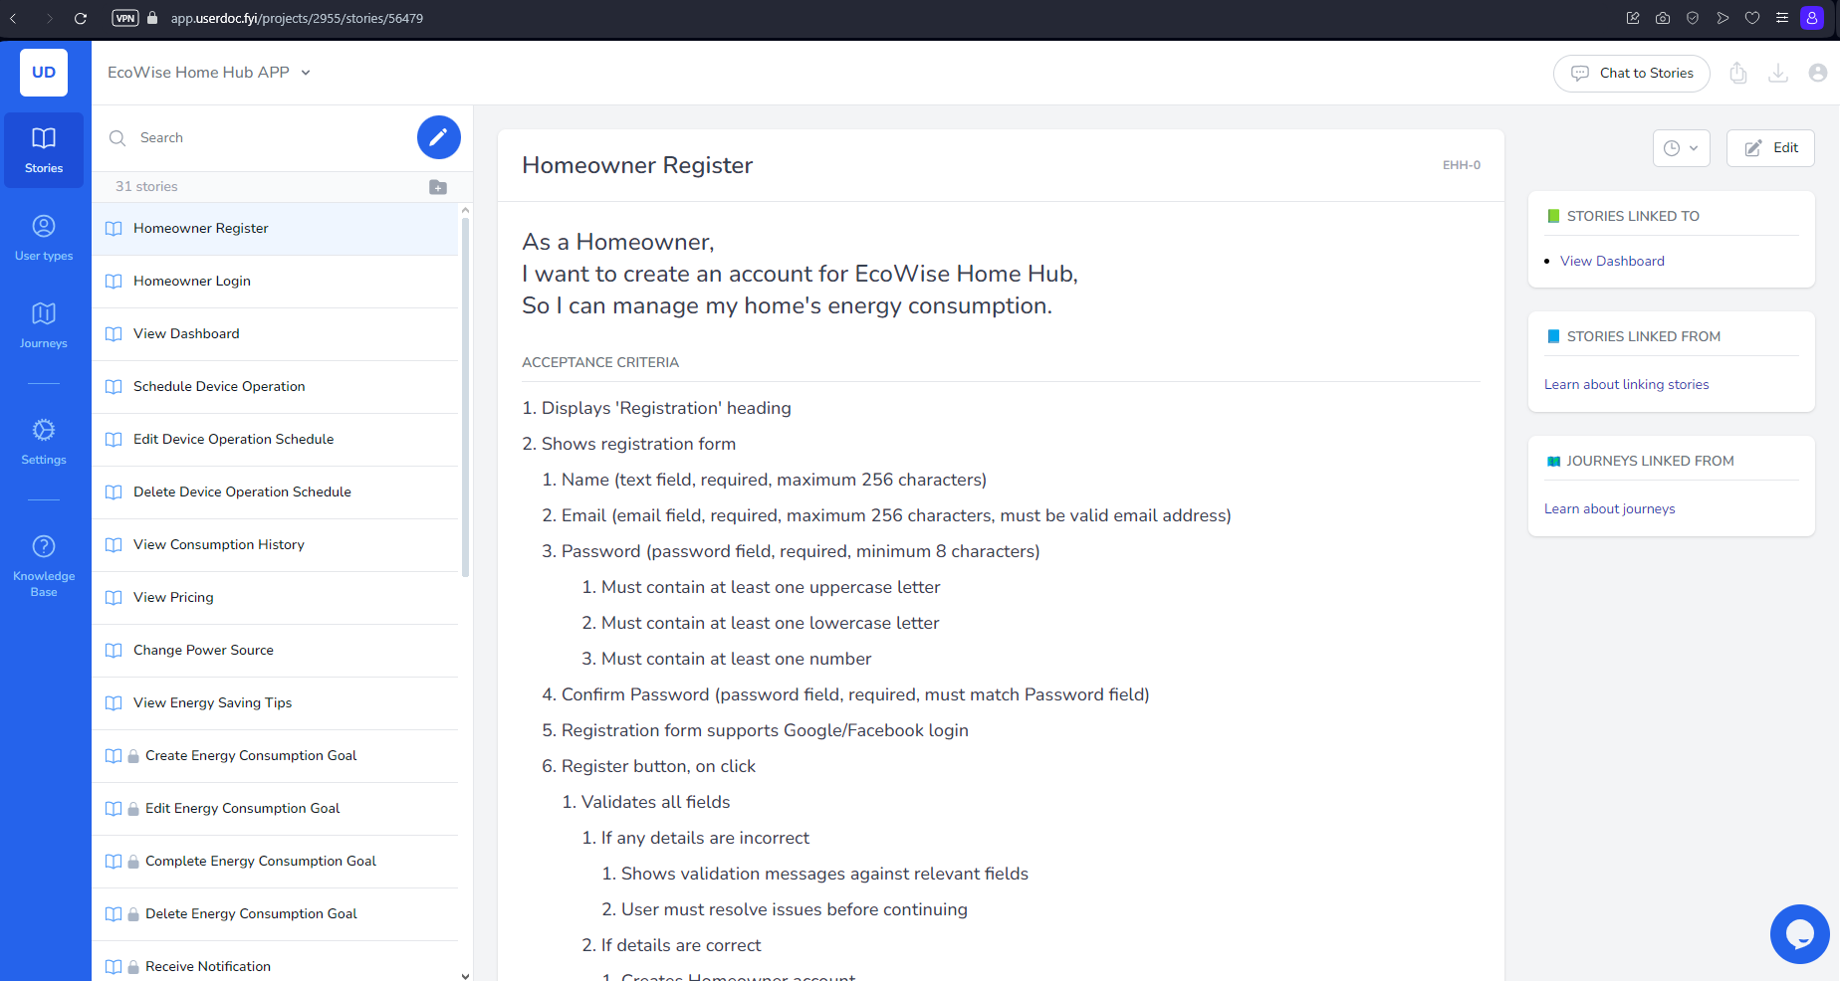
Research references/Additional information

Slide 8
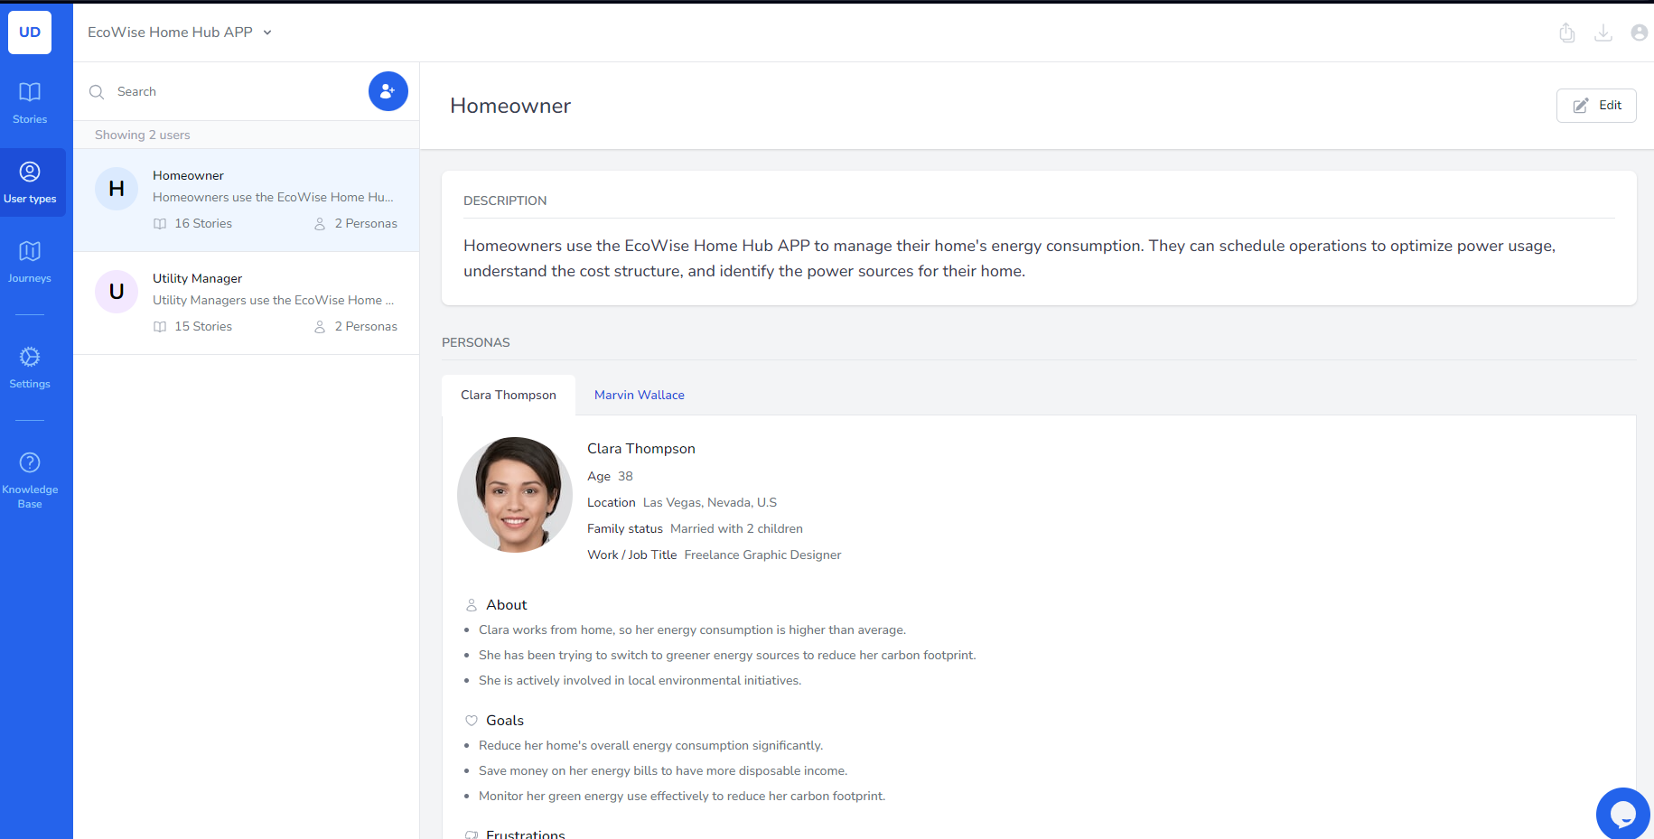
Research references/Additional information

Slide 9
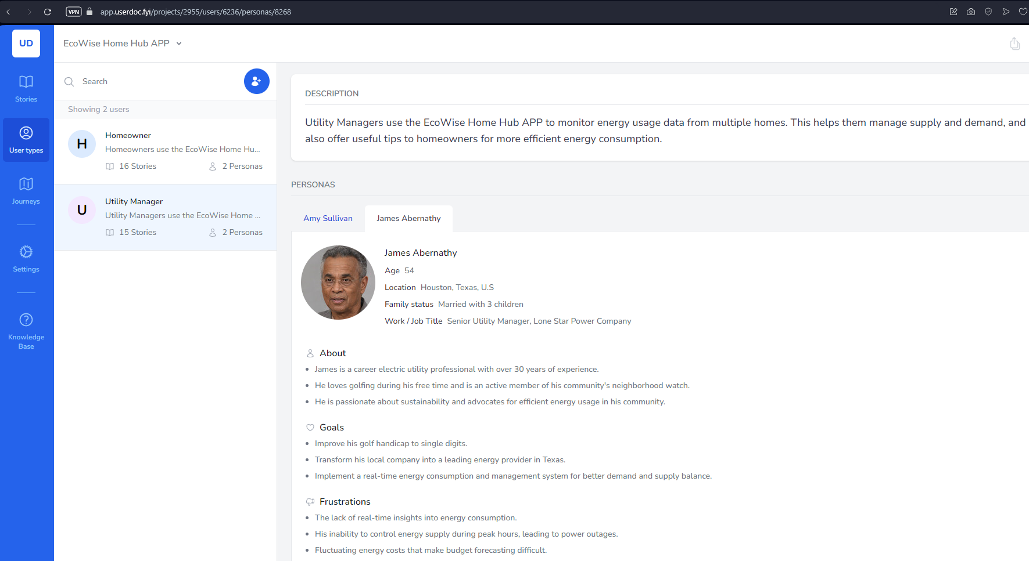
Research references/Additional information

Slide 10
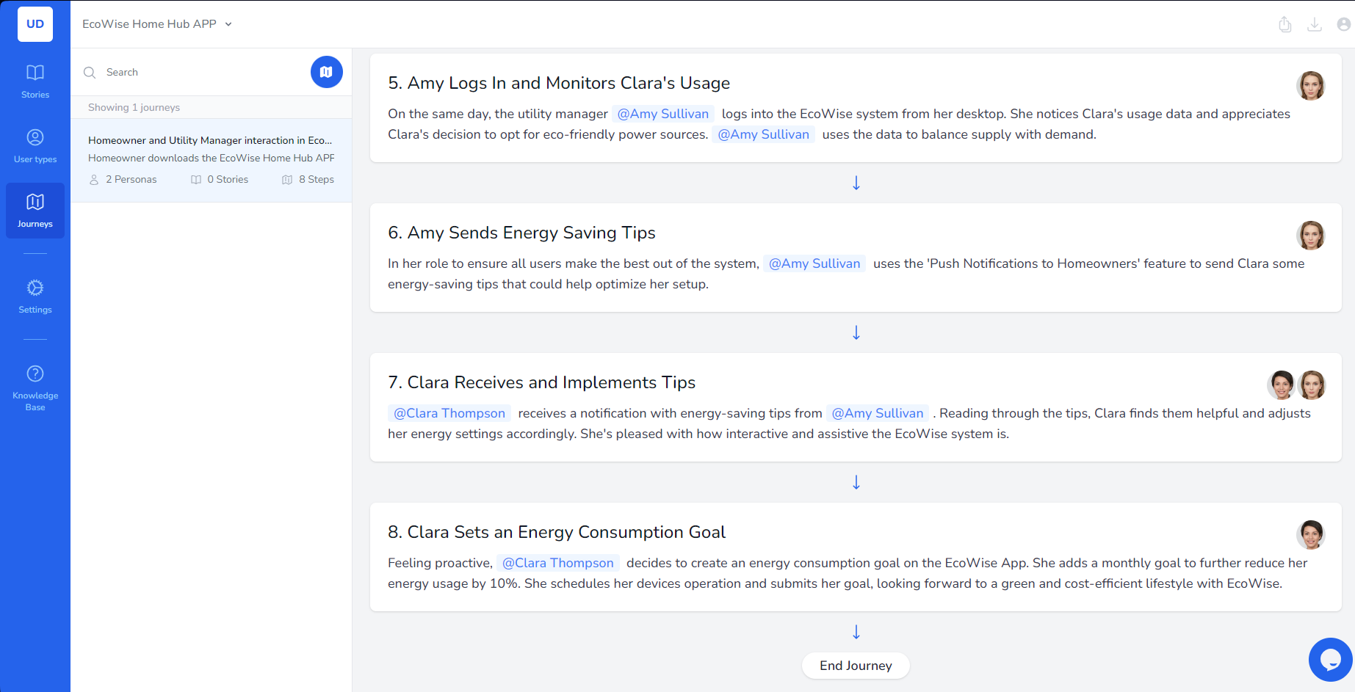
Research references/Additional information

Slide 11
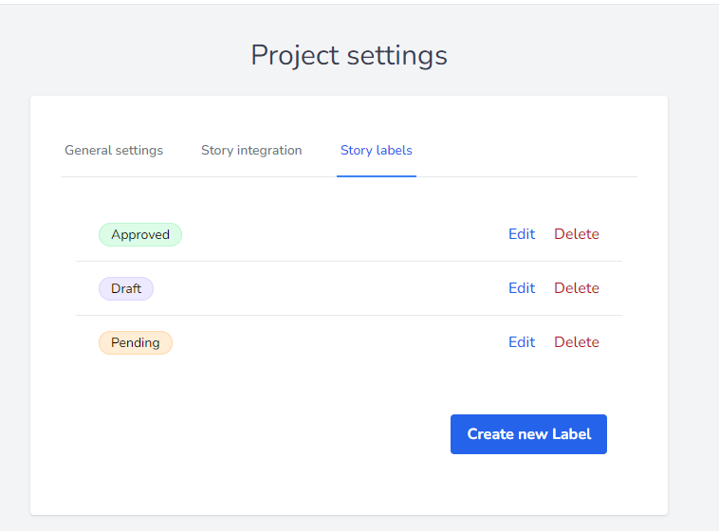
Research references/Additional information

Slide 12
Project Management and Resource Allocation
Tools
Taskade is a professional tool for requirements and project management
To integrate AI into our project we chose Taskade for the following reasons:
Taskade is a collaboration app that mixes real-time collaboration with task management and artificial intelligence (AI). It's best for small remote teams looking to collaborate and manage work online, and affordable pricing sweetens the deal.
It is very intuitive, has an Ai assistant, Instantly generate task lists, mind maps, meeting agendas, and custom workflows. Engages with an intelligent AI assistants and collaborate with your team, all within one unified workspace.
https://www.taskade.com https://github.com/taskade

Slide 13
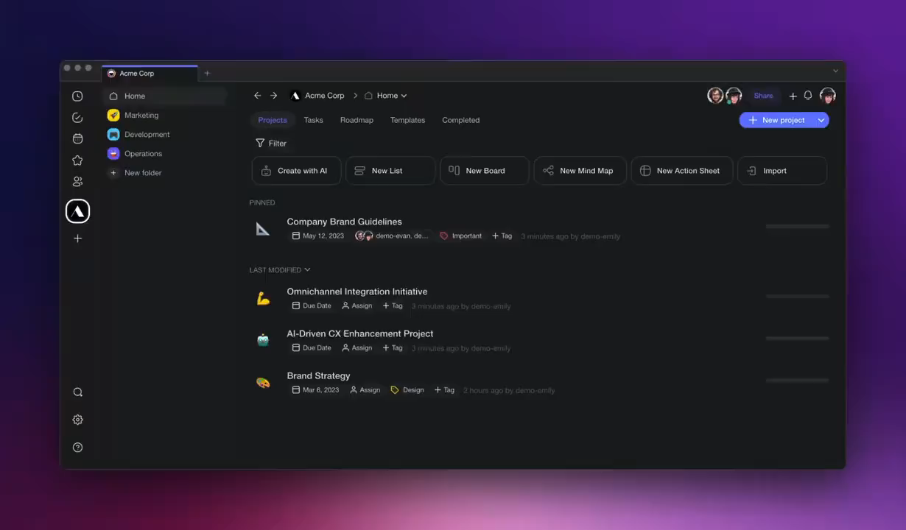
Research references/Additional information
*play video

Slide 14
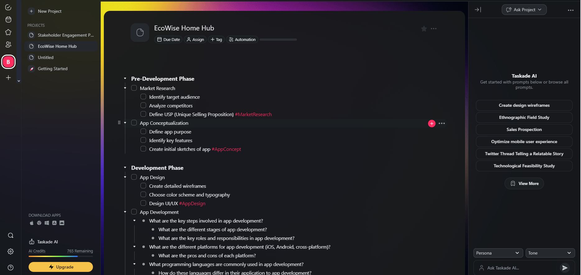
Research references/Additional information
https://www.taskade.com https://github.com/taskade

Slide 15
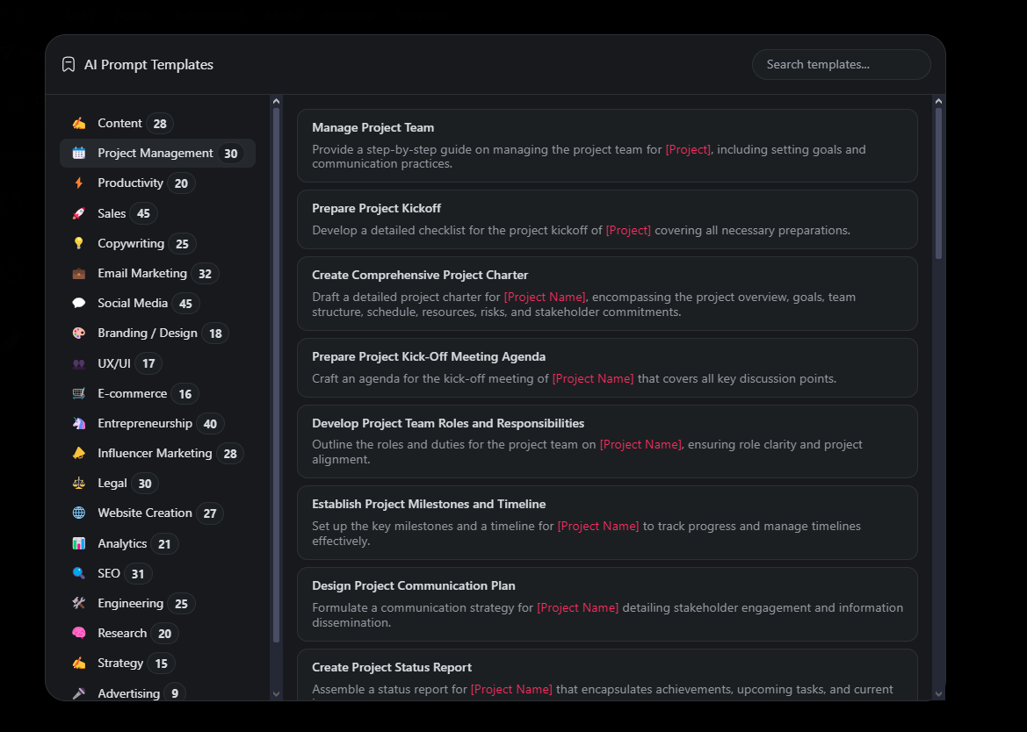
Research references/Additional information

Slide 16
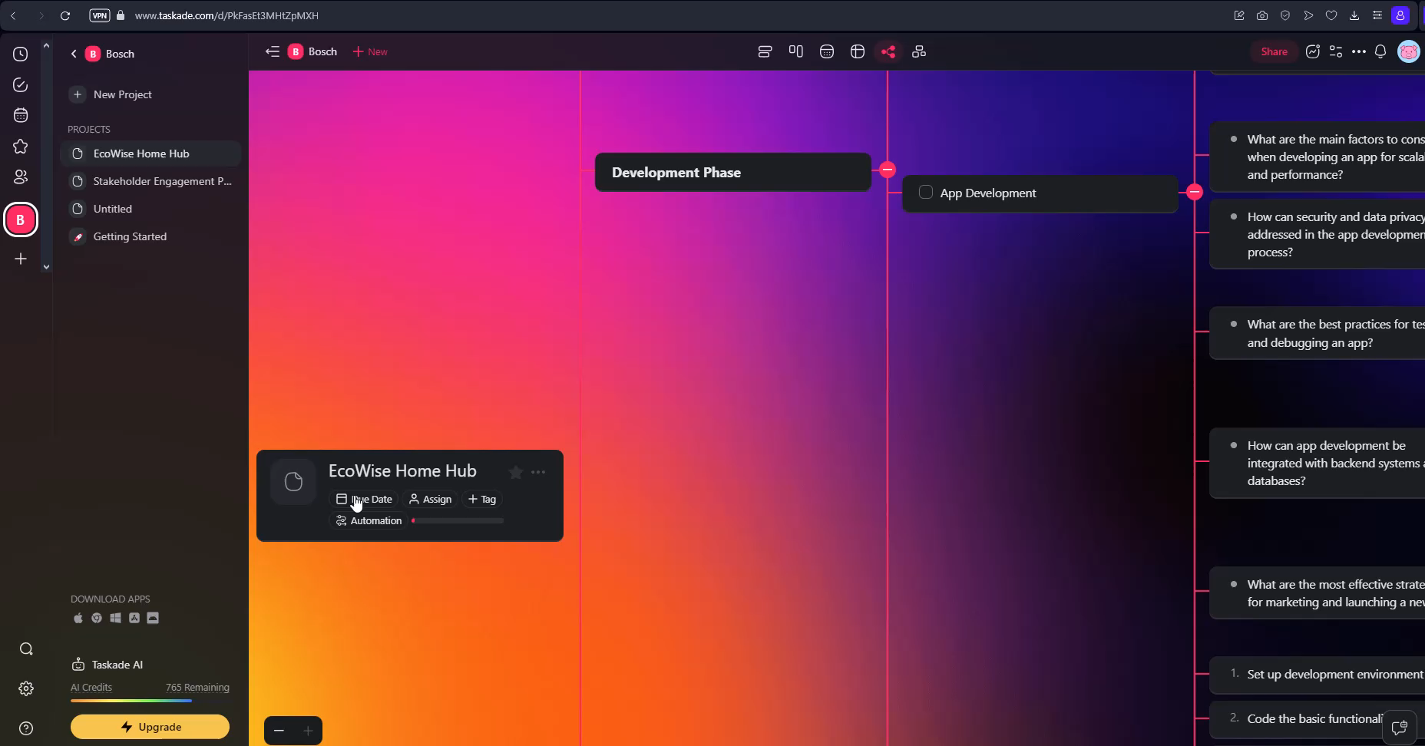
Research references/Additional information
*play video

Slide 17
UX/UI enhancements
Tools
Figma and Adobe XD are the most used professional tools for UX/UI.
To integrate AI into our project we chose Figma for the following reasons:
Collaboration: Multiple users can work on the same file simultaneously, making it ideal for team collaboration.
Cross-platform compatibility: Figma is entirely web-based, which means you can access and work on your designs from any device with a web browser.
Plugins and integrations: Figma has a growing ecosystem of plugins that extend its functionality and integrate with other tools and services.
Community and resources: Figma has a strong and active community of designers who share resources, tips, and tutorials.
We can make UI/UX development easier using AI technologies such as:
Builder.io - is a plugin for Figma which provide the capability to integrate OpenAI service and generate designs for an app based on the app description provided by the user.
Figma to Brave Studio plugin is aimed at facilitating the transfer of design from Figma to Brave Studio which create an app based on the received design.
https://www.builder.io/
https://www.figma.com/community/plugin/1149380850484102424

Slide 18
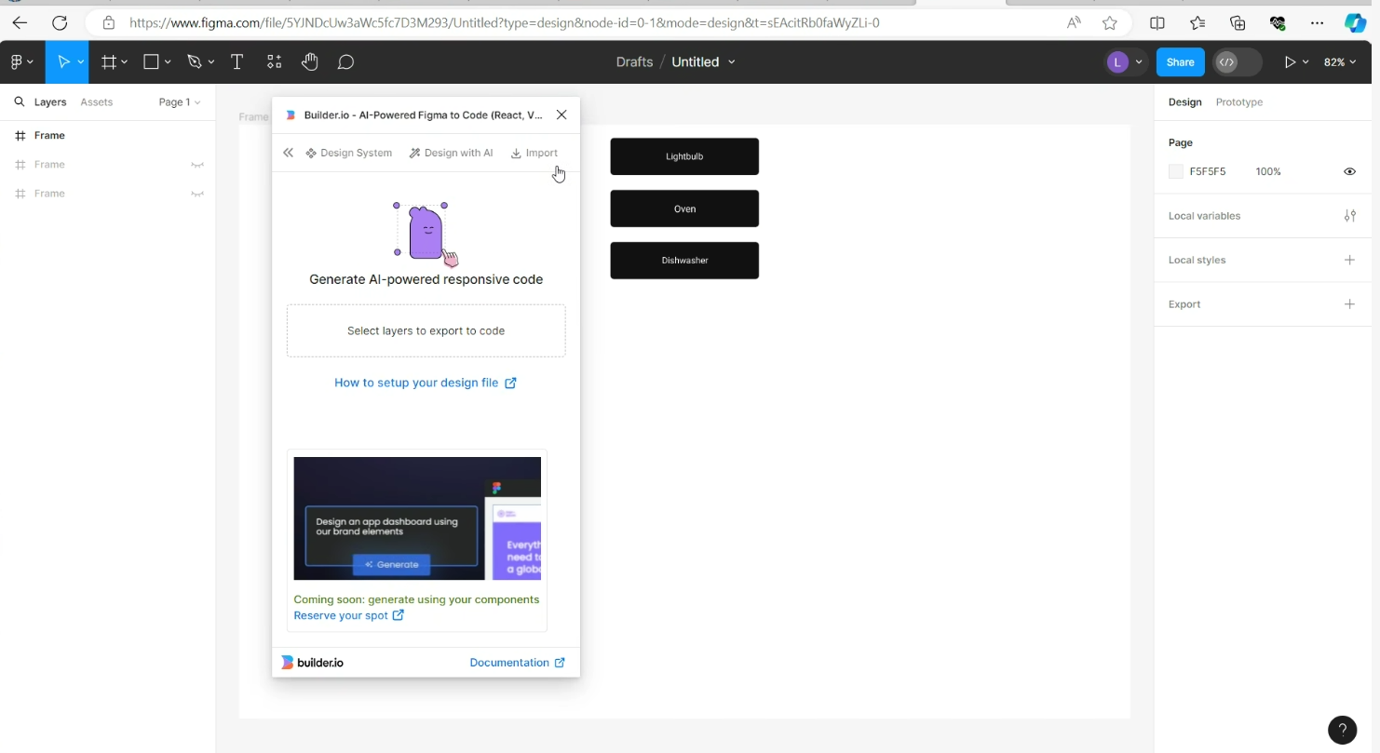
Research references/Additional information
UX/UI
https://www.figma.com/community/plugin/1149380850484102424

Slide 19
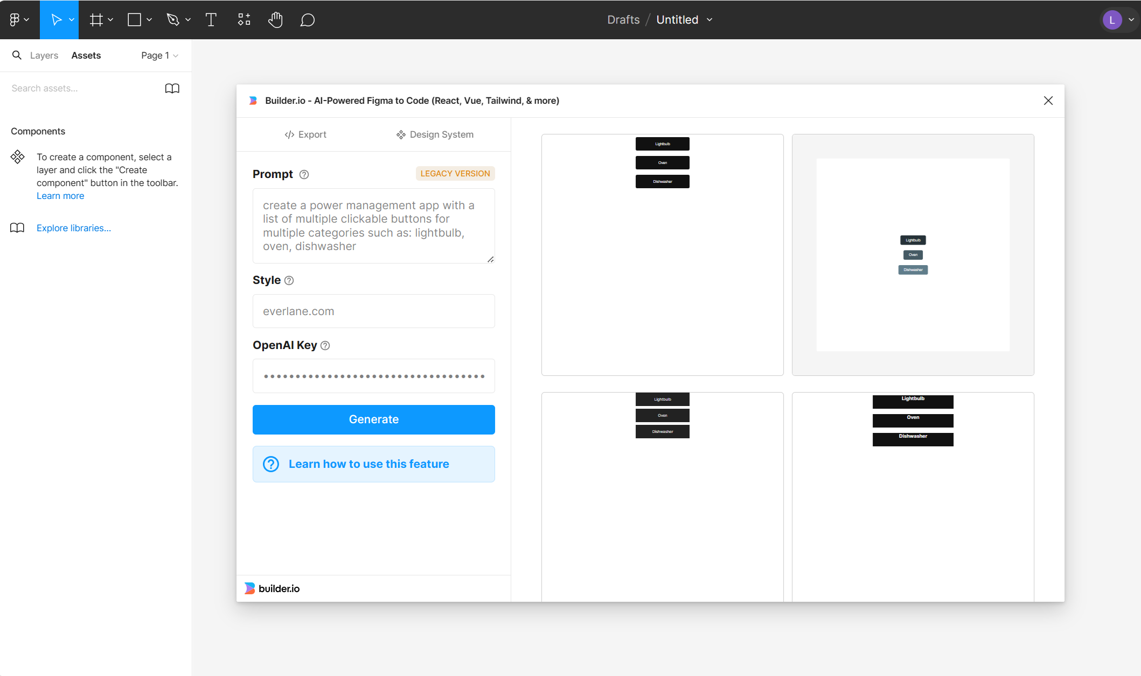
Research references/Additional information

Slide 20
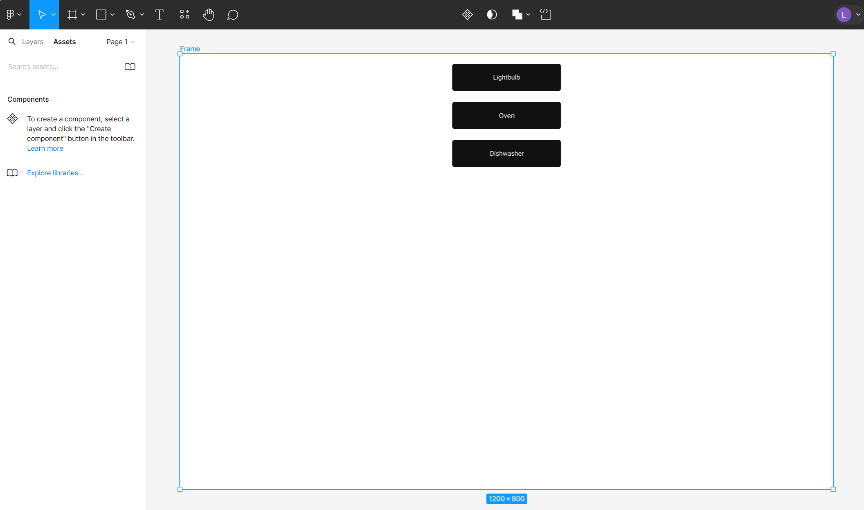
Research references/Additional information

Slide 21
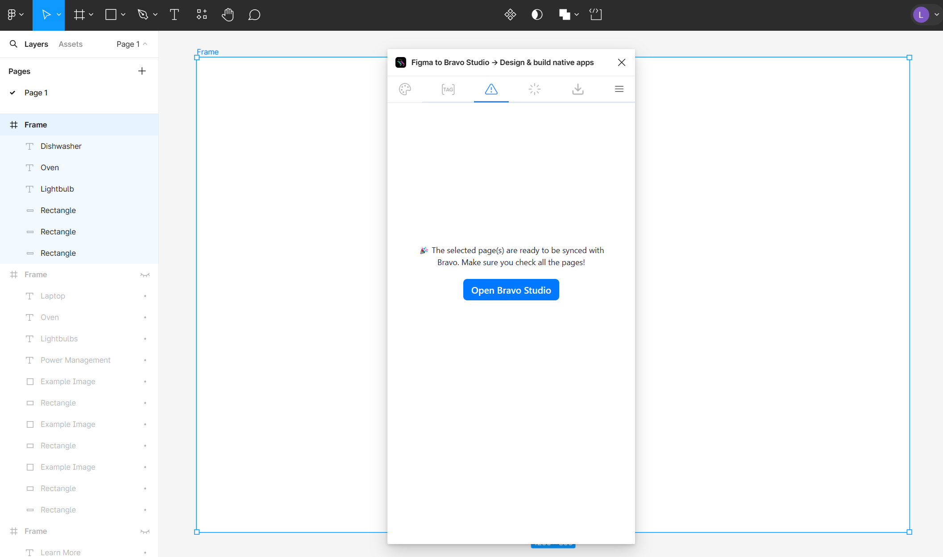
Research references/Additional information

Slide 22
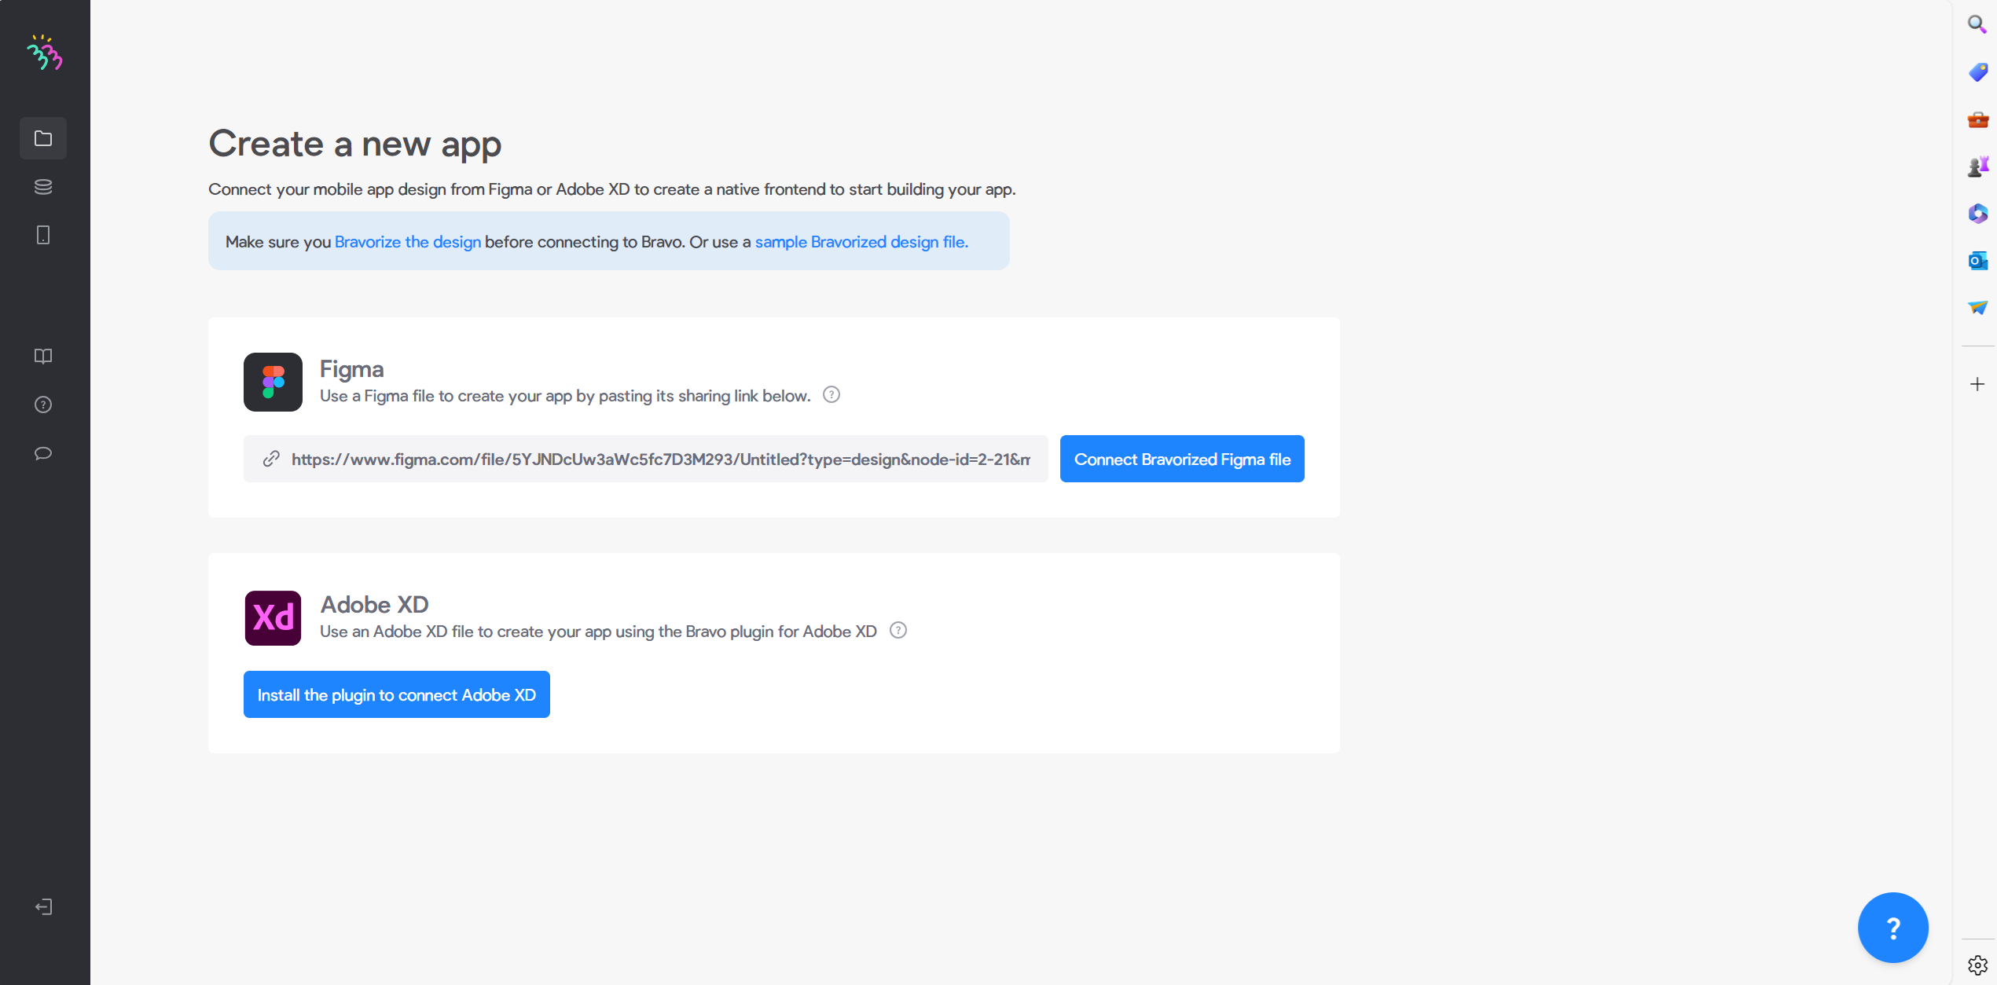
Research references/Additional information

Slide 23
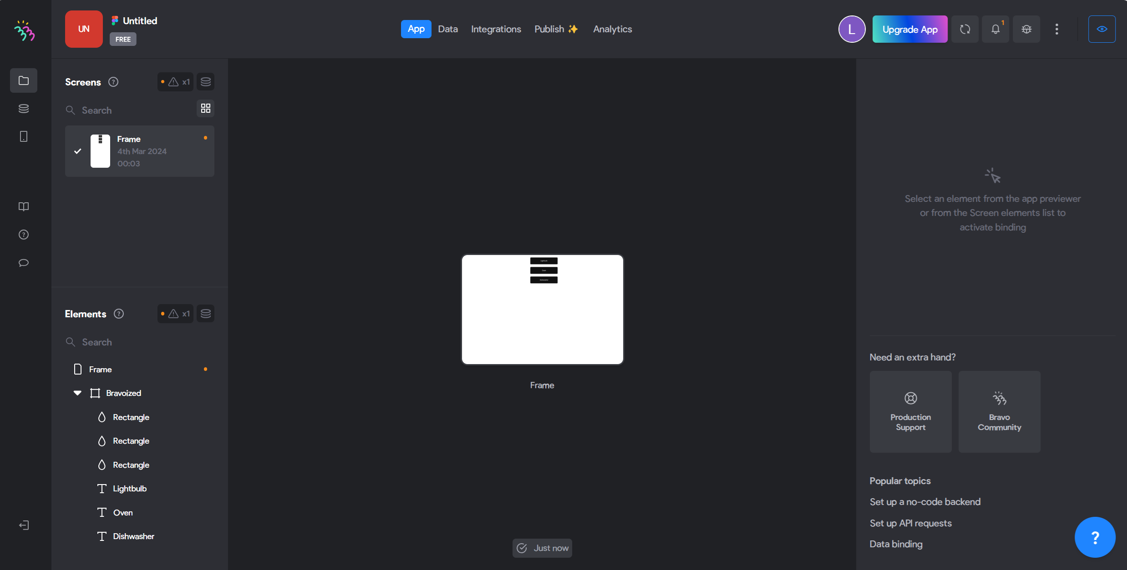
Research references/Additional information

Slide 24
Code Generation and Optimization - frontend
Tools
FlutterFlow is a browser-based drag and drop interface to visually build mobile or web apps without writing code. It is a visual app builder on top of Google's Flutter (the most popular cross platform developer framework) that allows Nymbl to build apps faster and easier, with less code.
FlutterFlow apps are built using Dart, the primary language behind Flutter.
Flutter Flow offers several notable features that contribute to its popularity among Flutter developers.
We crated a simple, intuitive yet beautiful UI, generated clean code, that we can deploy to the app stores or web in one click. It is fully extensible with custom code if necessary.
Using FlutterFlow, we can create high-quality Flutter apps for multiple platforms from a single codebase without manually coding entire interfaces.
Its integration with Firebase provides a high level of security of data which adds a layer of reliability.
Firebase is a platform for building mobile and web applications which is used in real-time databases, authentication, cloud messaging, and more.
It also offers a free, open-source version via GitHub
https://github.com/FlutterFlow https://app.flutterflow.io/ https://www.nymbl.app/platform/what-is-flutterflow https://dart.dev https://youtu.be/buc7l8g2cqg?si=FE9T1SnyqoP17PLE

Slide 25
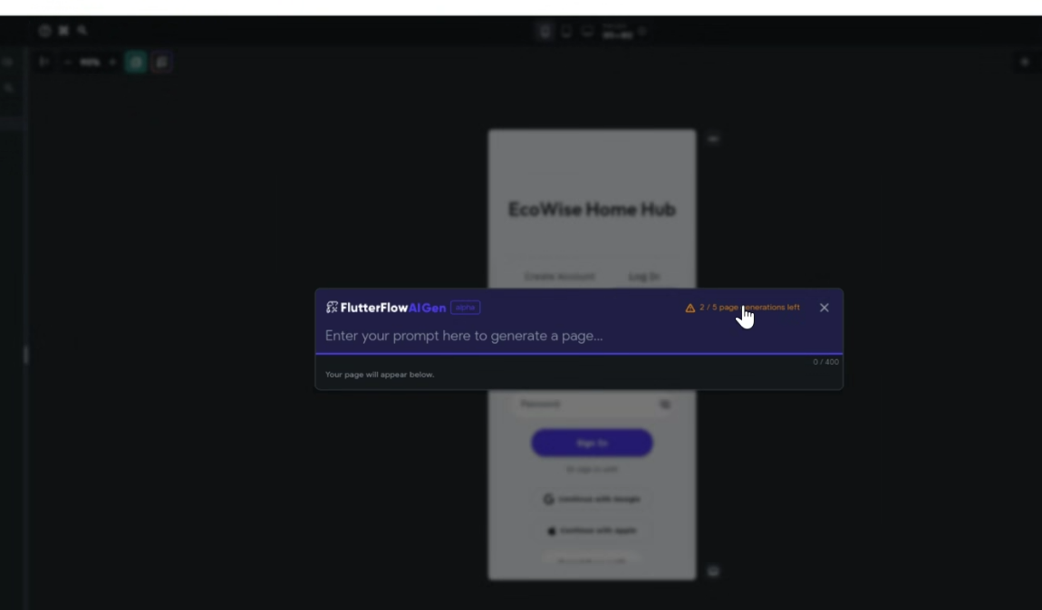
Research references/Additional information

Slide 26
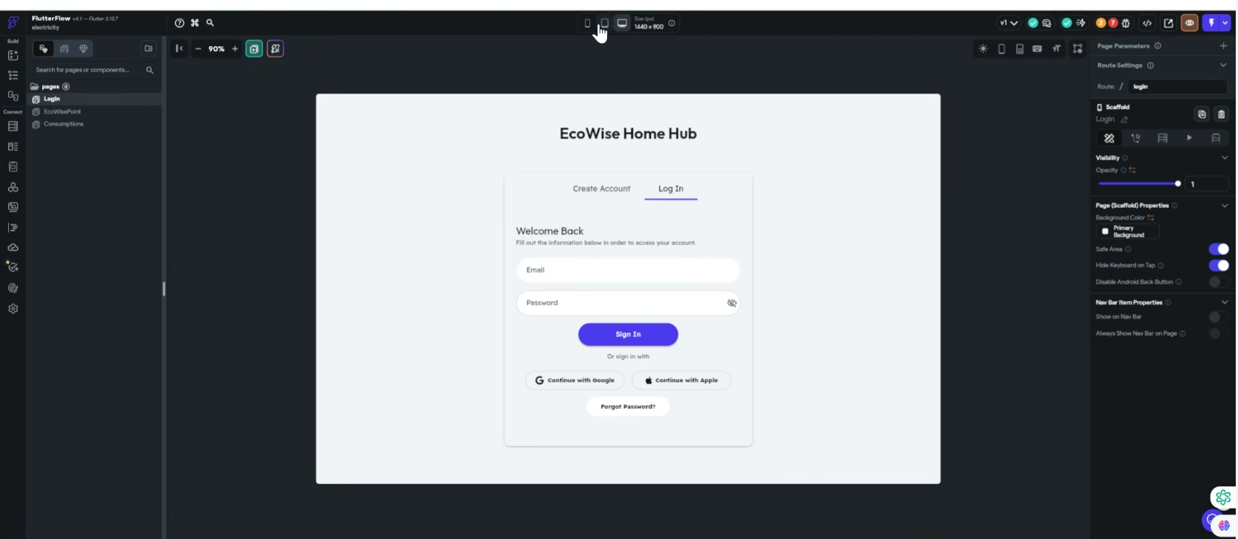
Research references/Additional information
https://app.flutterflow.io/

Slide 27
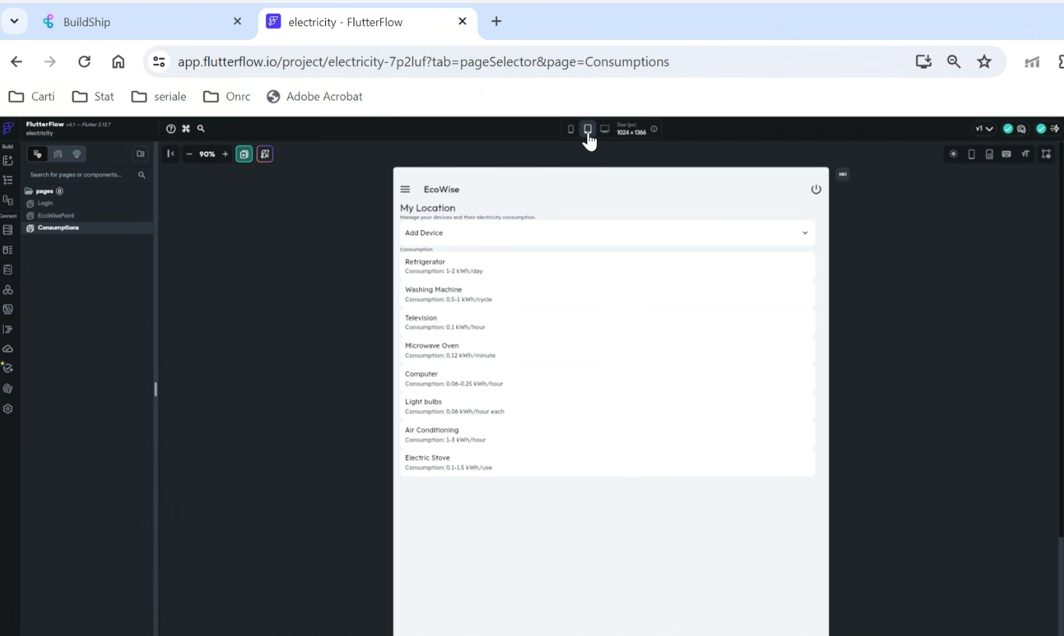
Research references/Additional information

Slide 28
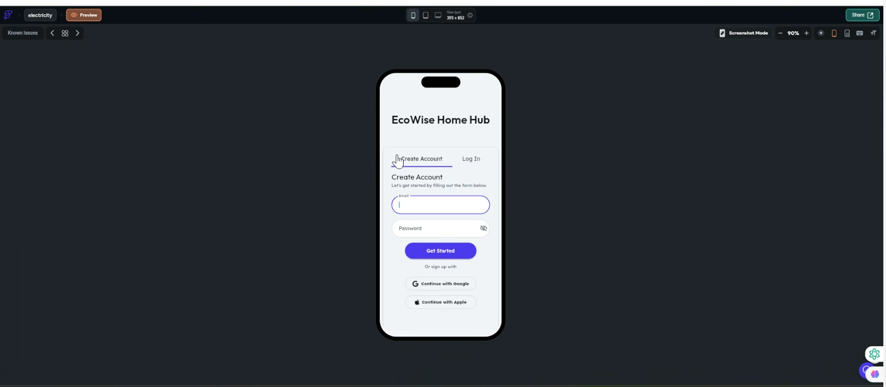
Research references/Additional information
https://app.flutterflow.io/

Slide 29
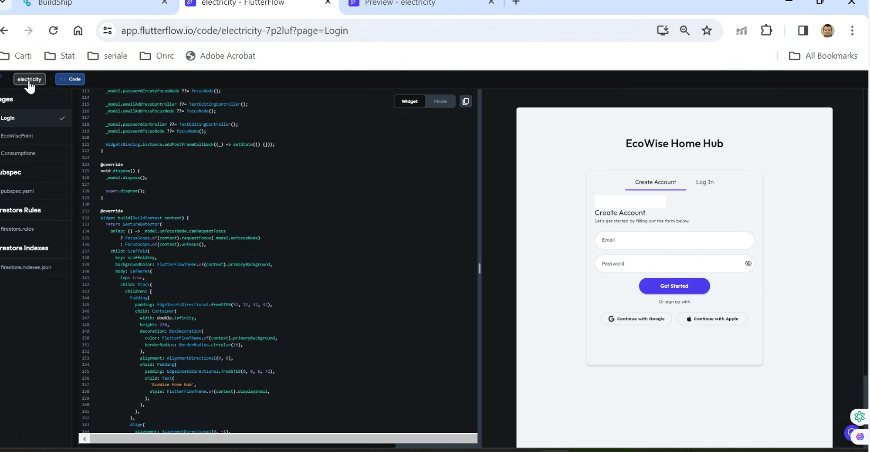
Research references/Additional information
https://app.flutterflow.io/

Slide 30
Code Generation and Optimization - backend
Tools
Buildhip.io is a low-code Visual Backend Builder. Create APIs, scheduled jobs, and backend workflows - powered by AI. With this tool we aimed to crate the backbone of our synthetic application
Buildship is a very powerful tool that can help us with many details regarding the backend implementation phase, 🚀 APIs🚀 Scheduled Jobs🚀 Backend tasks 🚀 Connect with any 3rd party APIs and tools
🚀 Integrate with any AI model
For the apps we are building, with no-code app builders (FlutterFlow) or frontend frameworks (Next.js, React) we need a backend to support scalable APIs, secure workflows, automation, etc. BuildShip gives us a completely visual way to build these backend tasks scalably in an easy-to-use fully hosted experience
https://github.com/rowyio/buildship https://buildship.com https://youtu.be/9GGpOooWwIU?si=qcArKloD6zVoD0sD https://discord.com/channels/853498675484819476/1004704796969807884

Slide 31
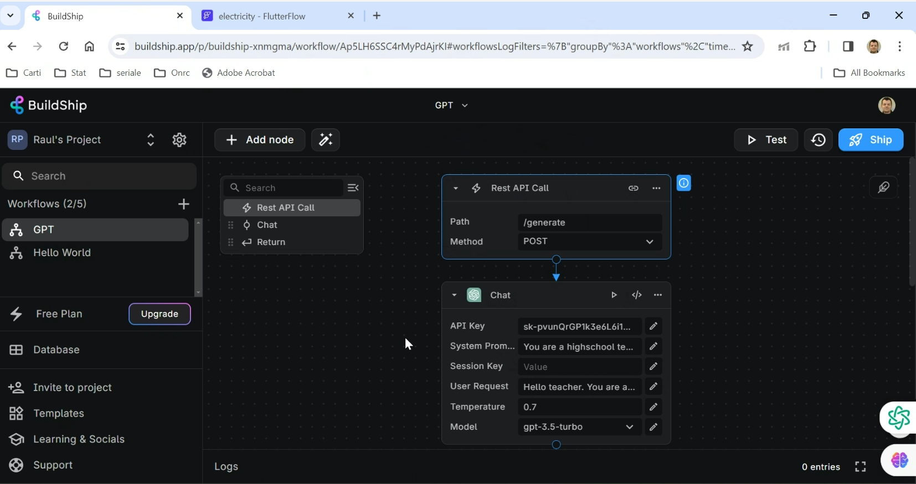
Research references/Additional information
https://github.com/rowyio/buildship https://buildship.com

Slide 32
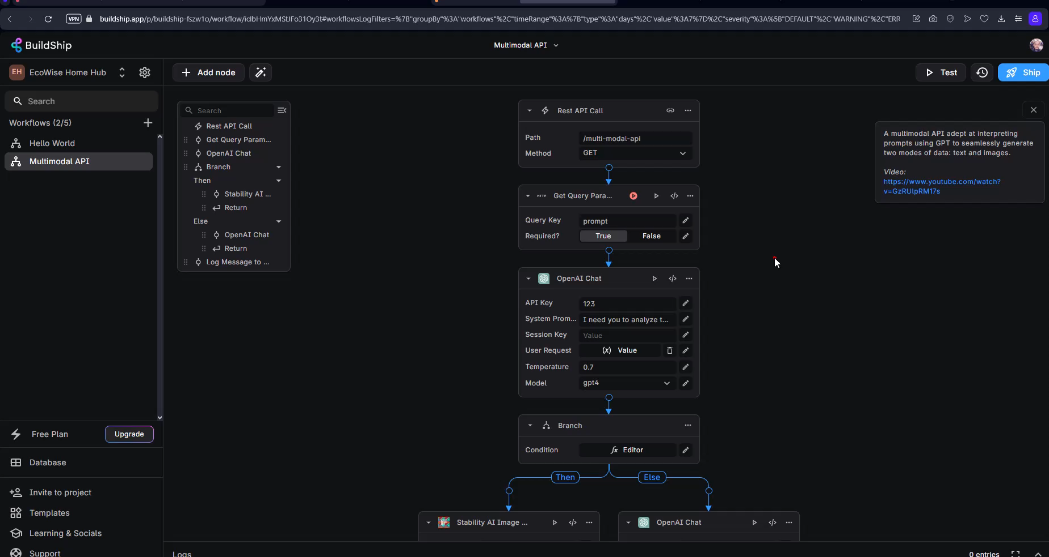
Research references/Additional information
https://github.com/rowyio/buildship https://buildship.com

Slide 33
Infrastructure, Build, and Deployment Automation & Monitoring
Tools
Teleport is a very powerful AI driven toolkit that can help you become cloud ready in minutes and improve productivity while onboarding and offboarding
Teleport Assist is an AI-powered platform that simplifies infrastructure access for DevOps teams by providing extended AWS KMS support, and a standalone Kubernetes Operator, aimed at elevating access and security across platforms. It also includes crucial breaking changes and improvements in SSH connection resumption, device trust for Linux, and integration with EKS secure and convenient solutions for managing privileged access
https://ecowisehomehub.teleport.sh/web/cluster/ecowisehomehub.teleport.sh/requests/new

Slide 34
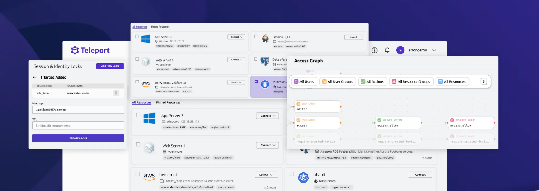
Research references/Additional information
https://goteleport.com/docs/machine-id/deployment/jenkins/

Slide 35
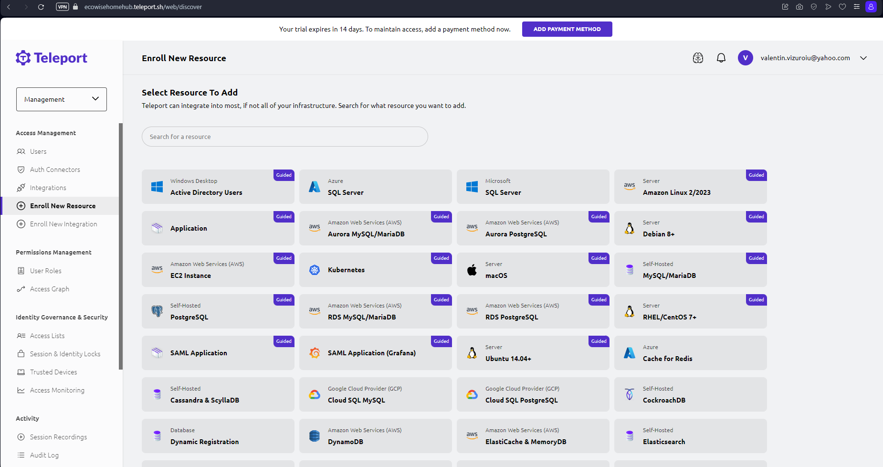
Research references/Additional information

Slide 36
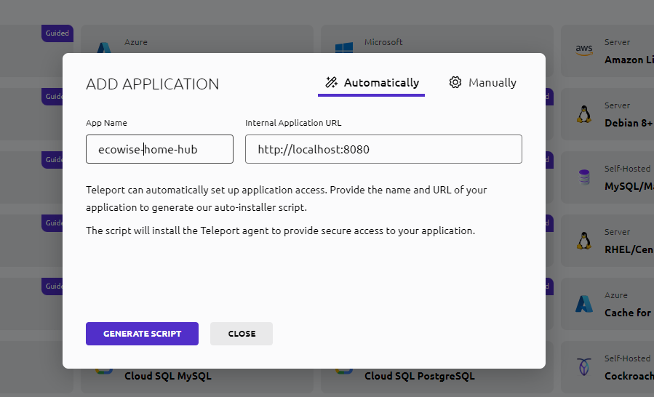
Research references/Additional information

Slide 37
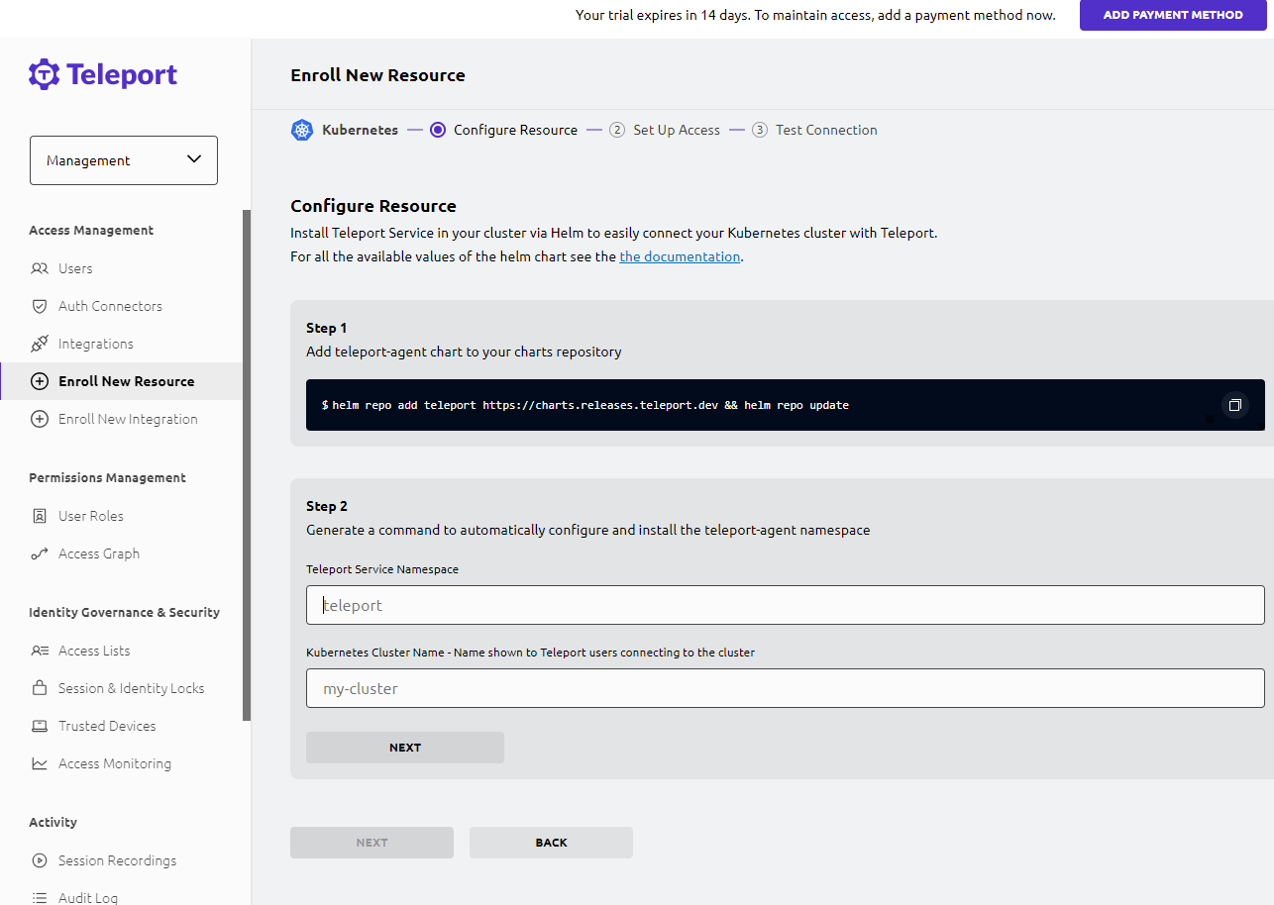
Research references/Additional information

Slide 38
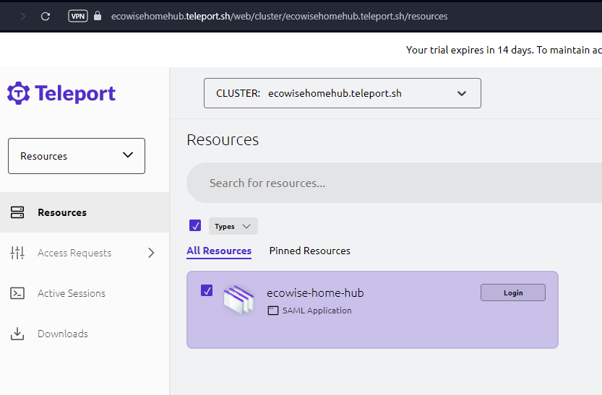
Research references/Additional information

Slide 39
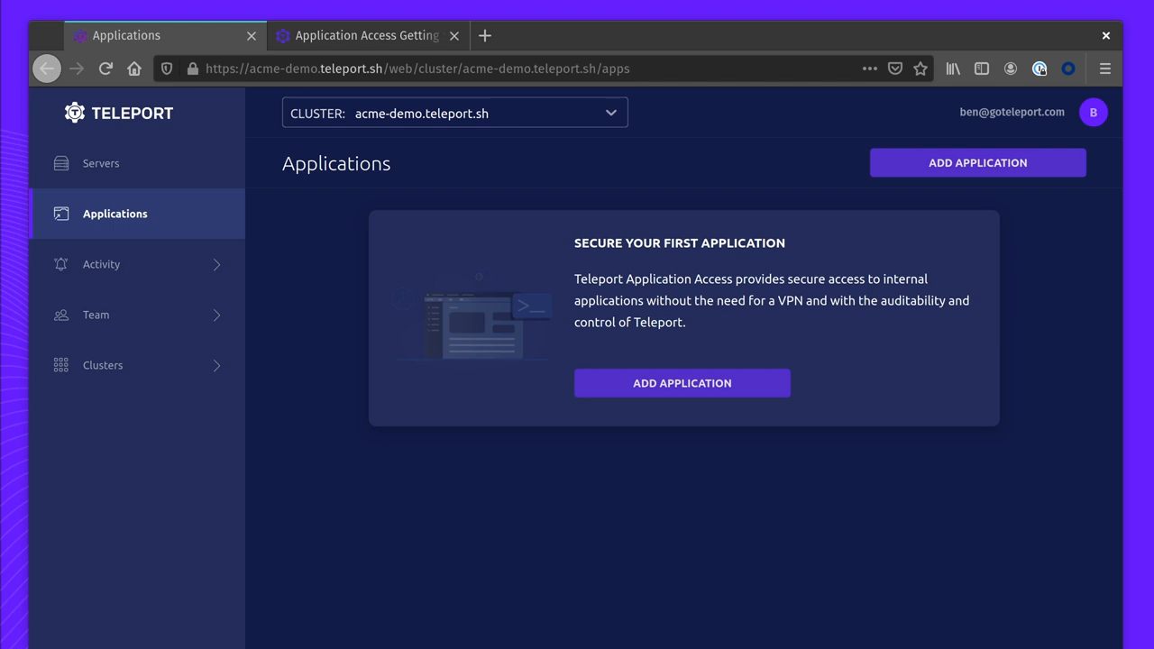
Research references/Additional information
*play video

Slide 40

Research references/Additional information
*play video
https://github.com/geohot George Hotz -commaai

Slide 41

Test Automation
Tools
TestRigor is a test automation tool that utilizes AI to simplify the test automation process.
Is a tool who incorporate all stages: test cases generation, test execution and test reporting, compared to other tools which targets only one stage of these.
https://testrigor.com/

Slide 42
Test Automation
Tools
Here are some reasons why someone might consider choosing TestRigor over other test automation tools:
AI-Powered Script Generation:
This can potentially speed up the test automation process, especially for teams or individuals who may not have extensive programming knowledge.
Codeless or Low-Code Approach:
Tests can be created and maintained without delving deeply into scripting.
Dynamic Element Recognition:
This can be beneficial in scenarios where web applications frequently have changes in their user interface.
Natural Language Processing (NLP):
The incorporation of natural language processing in TestRigor might make it easier for users to express test scenarios in a human-readable format.
Cross-Browser Testing:
TestRigor's support for cross-browser testing can be advantageous if the app need to run in multiple browsers.
Integration with CI/CD Pipelines:
TestRigor's integration with CI/CD pipelines allows for the seamless automation of tests and promotes a more efficient process
Report Generation and Analytics:
Tests reports provided by TestRigor may assist in tracking test results and identifying issues.
https://testrigor.com/

Slide 43
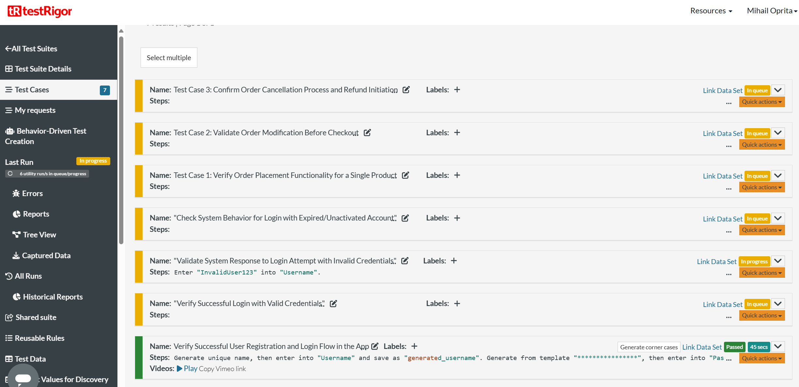
Research references/Additional information

Slide 44
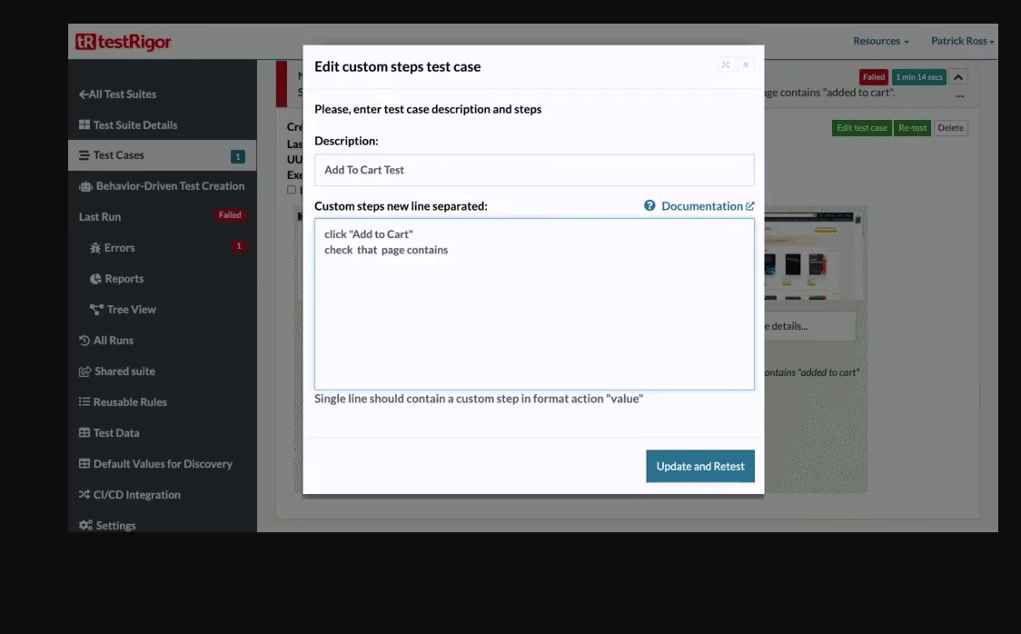
Research references/Additional information

Slide 45
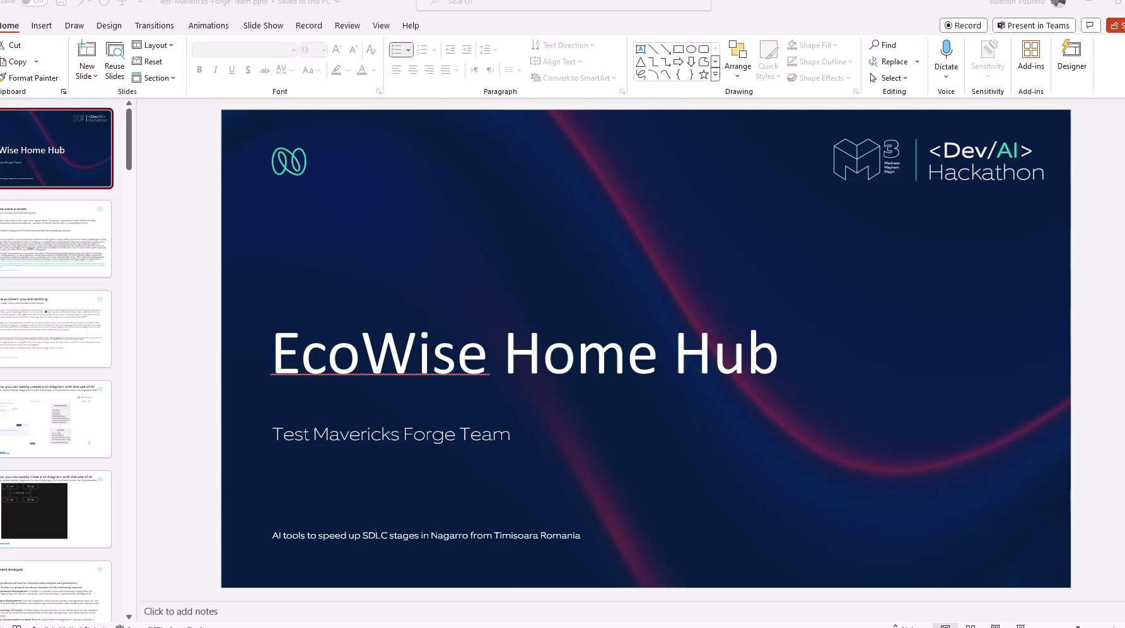
We summarized everything in this video

Slide 46
Research references/Additional information
We used AI-powered tools throughout every stage of the Software Development Life Cycle (SDLC). And did some reasearch we included here
https://userdoc.fyi - Requirement Analysis
https://www.taskade.com/ - Project Management and Resource Allocation
https://www.eraser.io –Diagrams
https://diagrammingai.com - Diagrams
https://www.builder.io/ -UI /UX
https://www.figma.com/community/plugin/1149380850484102424 -UI /UX
https://buildship.com/ - Low-code Backend Builder
https://goteleport.com/ -Infrastructure, Build, and Deployment Automation & Monitoring
https://testrigor.com/ - Test Automation and QA"
https://topai.tools/ - A plethora of new tools
https://huggingface.co/datasets - Inspiration
https://substack.com/profile/40374701-vesa-alexandru AI tips and tricks
https://www.goodreads.com/en/book/show/144405196 Fei-Fei Lee epic book
Remember: “Your shell belongs to them, but not your ghost. Your ghost is yours.
EcoWise Home Hub -Test Mavericks Forge Team

Slide 47
Team details
valentin.vizuroiu@nagarro.com
laurentiu.oprita@nagarro.com
raul.portan@nagarro.com
valentin.vizuroiu@nagarro.com
none
none
Test Mavericks Forge Team - Timisoara / Romania

